Slide 1
Spring Caching Annotations Tutorial
Caching is crucial for today’s high performance applications.
There are many caching solutions available in market today namely EhCache, Guava Cache, Caffeine Cache, OScache, JBoss Cache,etc. Spring provides seamless integration with these caching solution using minimal configuration.
Spring Cache Abstraction is a set of interfaces and annotations, used for applying caching to Java methods. The idea is to cache the returned value of a method for a given input[method argument e.g.], and for any further request with same input, return the result from cache without even executing the method, thus reducing the number of executions. Spring’s org.springframework.cache.Cache and org.springframework.cache.CacheManager are main interfaces used for cache management. Do note that Spring Caching is still an abstraction [not a cache implementation] and requires an actual implementation in order to store the cache data.
Spring provides few out of the box abstraction implementations: JDK java.util.concurrent.ConcurrentMap based caches, EhCache, Caffeine, Gemfire cache, Guava caches and JSR-107 compliant caches. Other cache providers can be integrated with minimal configuration.

Slide 2
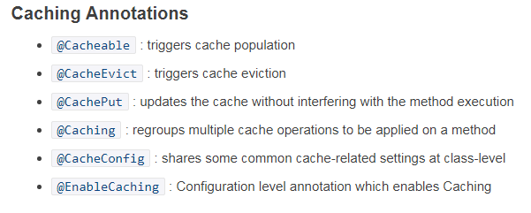
Spring Caching Annotations Tutorial

Slide 3
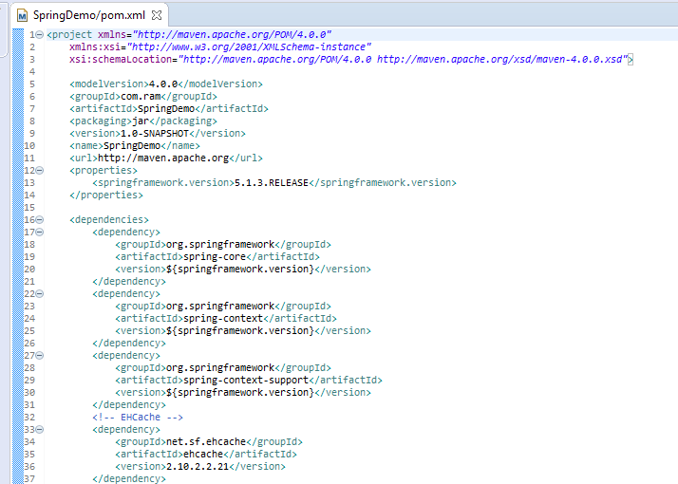
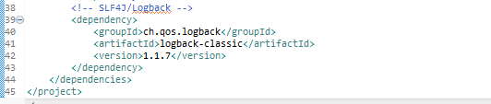
Spring Caching Annotations Tutorial

Slide 4
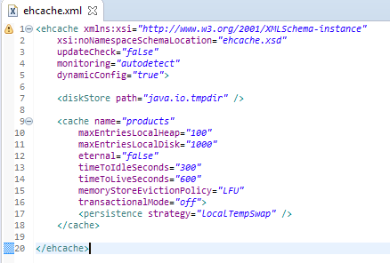
Spring Caching Annotations Tutorial
ehcache.xml providing the caching configuration for individual cache items.
Here we are setting up a cache with name ‘products’. Maximum 100 products will be kept in in-memory [on-heap] store, while maximum 1000 products will be maintained in the DiskStore.
The path specified ‘java.io.tmpdir’ which refers to default temp file path.
A product will be expired if it is idle for more than 5 minutes and lives for more than 10 minutes.
A detailed description of individual properties can be found at - http://www.ehcache.org/ehcache.xml

Slide 5
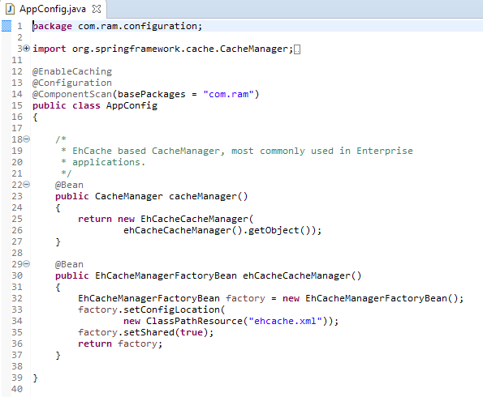
Spring Caching Annotations Tutorial
@EnableCaching [ Used for Enabling Caching support in Spring Application]
@EnableCaching annotation triggers a post processor that inspects every Spring bean for the presence of caching annotations[@Cacheable, @CacheEvict, @CachePut] on public methods. If such an annotation is found, a proxy is automatically created to intercept the method call and handle the caching behavior accordingly.

Slide 6
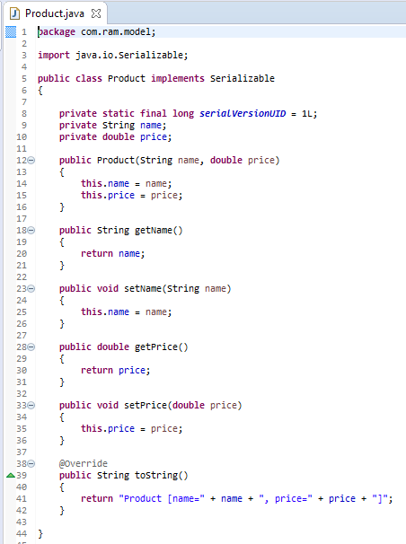
Spring Caching Annotations Tutorial

Slide 7
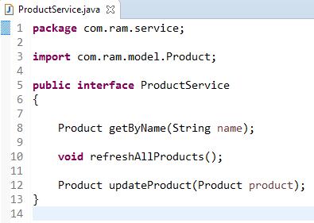
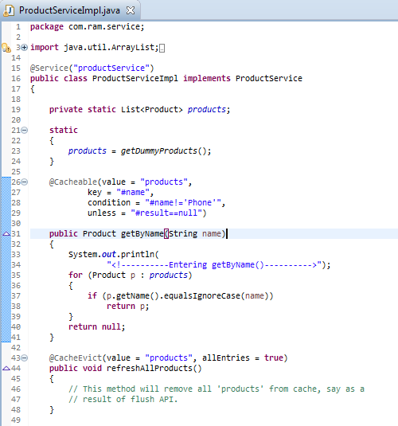
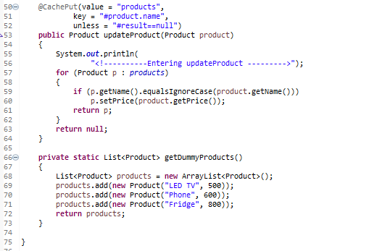
Spring Caching Annotations Tutorial
Products Cache
Key | Value
Key | Value
LED TV | LED TV Object
Fridge | Fridge Object

Slide 8
Spring Caching Annotations Tutorial
@Cacheable [ Used for populating and accessing Cache]
@Cacheable annotation indicates that the result of invoking a method (or all methods in a class) can be cached. A cache itself can be imagined as a key-value based Map.
First time a method annotated with @Cacheable gets called, it gets executed and it’s return value is stored in Cache using a key[method parameter for instance, ]. Next time, if the method gets called using same key[same parameter for instance], the result is returned directly from Cache, method invocation does not take place.
By default it uses the method parameters [product name in this case] to compute the key
@CacheEvict [ Used for removing items from Cache]
@CacheEvict annotation indicates that a method (or all methods on a class) triggers a cache evict operation, removing specific[or all] items from cache.
@CachePut
Used for Cache-update operation. Method annotated with @CachePut are always gets executed and there result gets stored in the cache, eventually overriding any entry with same key in cache.
Think about a product-refresh operation, where we want a specific product to be re-calculated [may be due to a new price] and then store that product in cache for any future reference. Note that while @CacheEvict is used to remove an item[or all of them] from cache, @CachePut is to update an item.

Slide 9
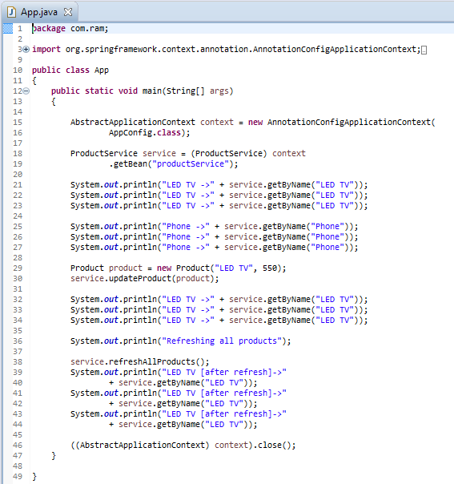
Spring Caching Annotations Tutorial

Slide 10
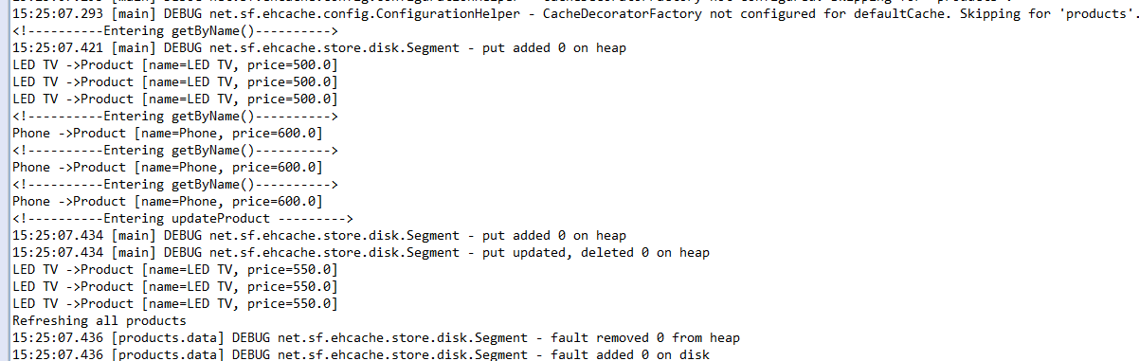
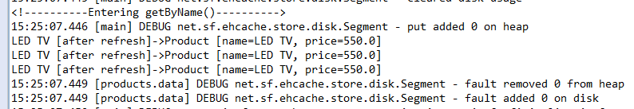
Spring Caching Annotations Tutorial

Slide 11
Spring Caching Annotations Tutorial
http://www.ehcache.org/ehcache.xml

